Slide 1
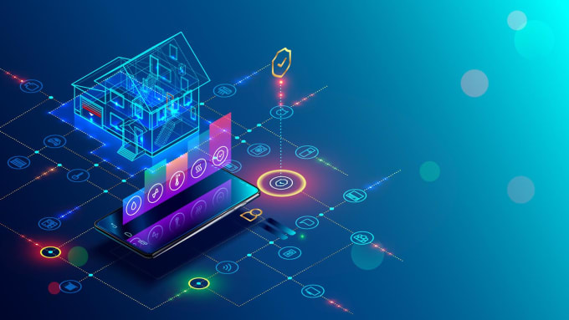
HOME AUTOMATION USING IOT
By Aman Mukati
112015011
Under guidance of
Dr. Nagendra Kushwaha

Slide 2
Node-mcu esp-8266
Developing energy efficiency and renewable energy technologies is becoming a priority and increasing the interest for many countries around the world.
introduction
The internet of things can be described as the technology in which the actual physical entities (electronic devices) with data sensing, processing & self adoption capacity can be used to interact with other such device.
The increase in the popularity of IoT has widely spread to simple in-home applications and everyday tasks.

Slide 3
MOTIVATION
To Reduce Human Effort
Controlling is easy
Accessibility range is higher
Helpful for elder’s to operate appliances .

Slide 4
objectives
IOT
Anytime Any context
Anyone Anybody
Any service any bussiness
Any path any network
Any place anywhere
Anything any device

Slide 5
LITERATURE REVIEW
DATA SENSING AND ACQUISITION
DATA TRANSMISSION
DATA PROCESSING
DATA DISPLAY AND USER INTERFACE

Slide 6
M
E
T
H
O
D
O
L
O
G
Y

Slide 7

Tools used

Slide 8
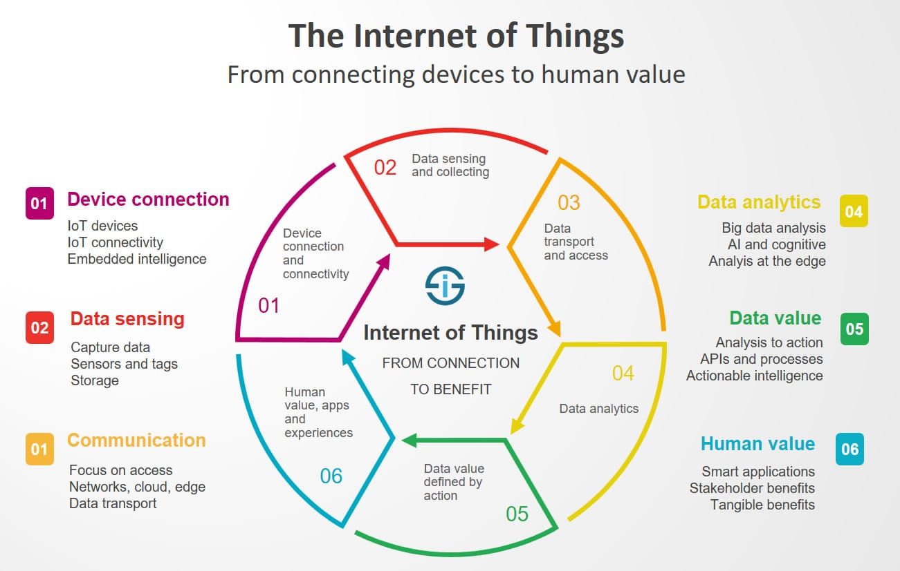
Technology used

Slide 9
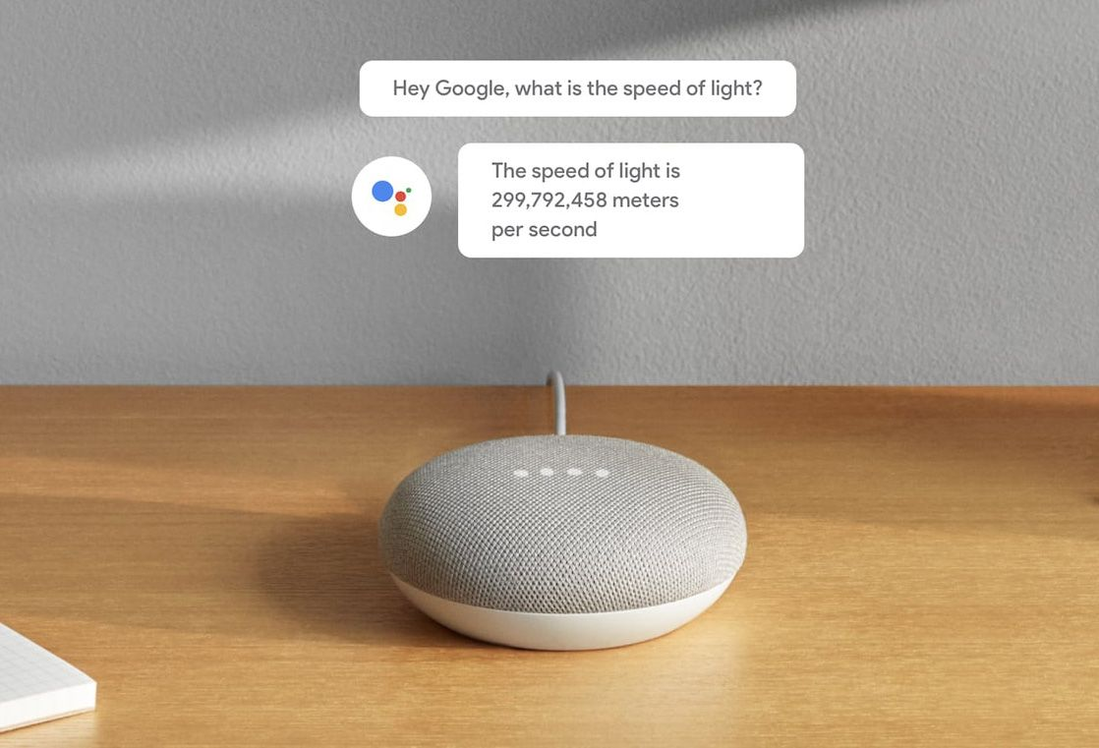

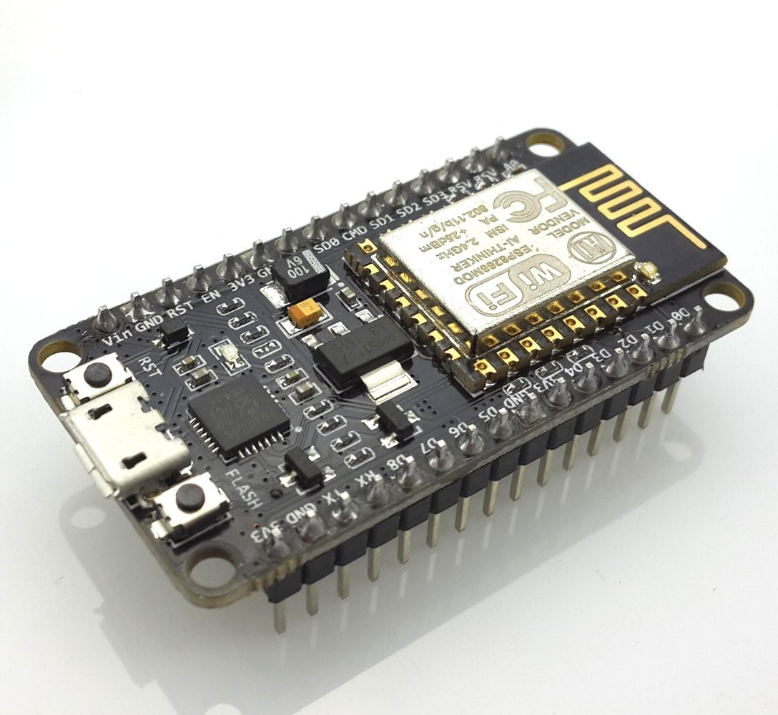
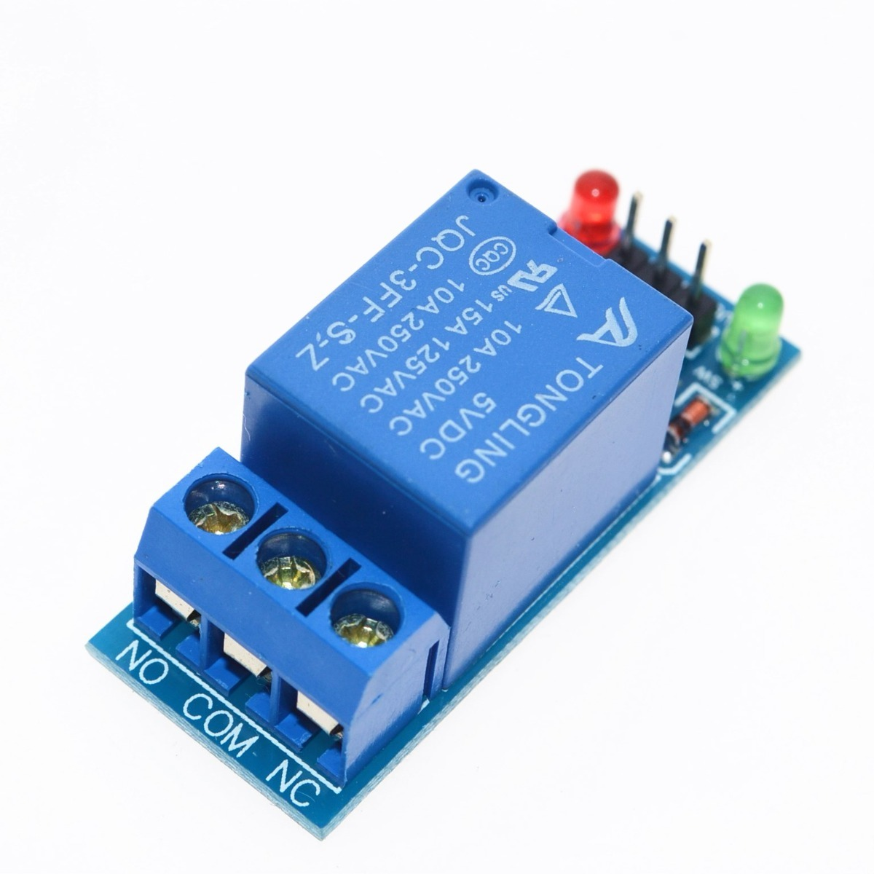
BLOCK DIAGRAM
GOOGLE HOME
BLYNK
APP
NODEMCU
ESP8266
RELAY
MODULE
20%
40%
60%
80%

Slide 10
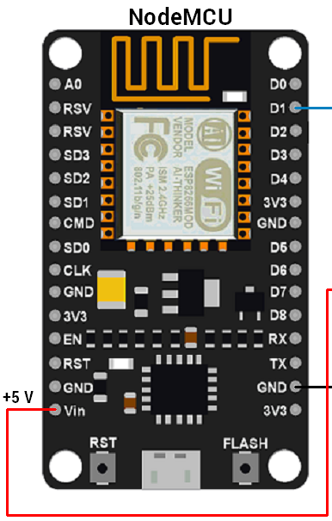
Nodemcu esp8266
1mib rom
80mhz clk
Low cost availability
Development board with wifi Soc
128 KB RAM and 4MB of Flash memory

Slide 11
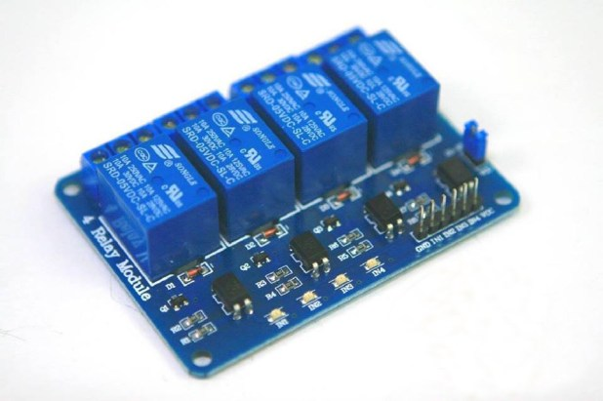
Relay module
It includes 5-pins & designed with plastic material
Good for safe control of higher amperage circuits.
Operating time 10millisecs,
Release time is 5msec
Normal Voltage is 5V DC
Normal Current is 70mA

Slide 12
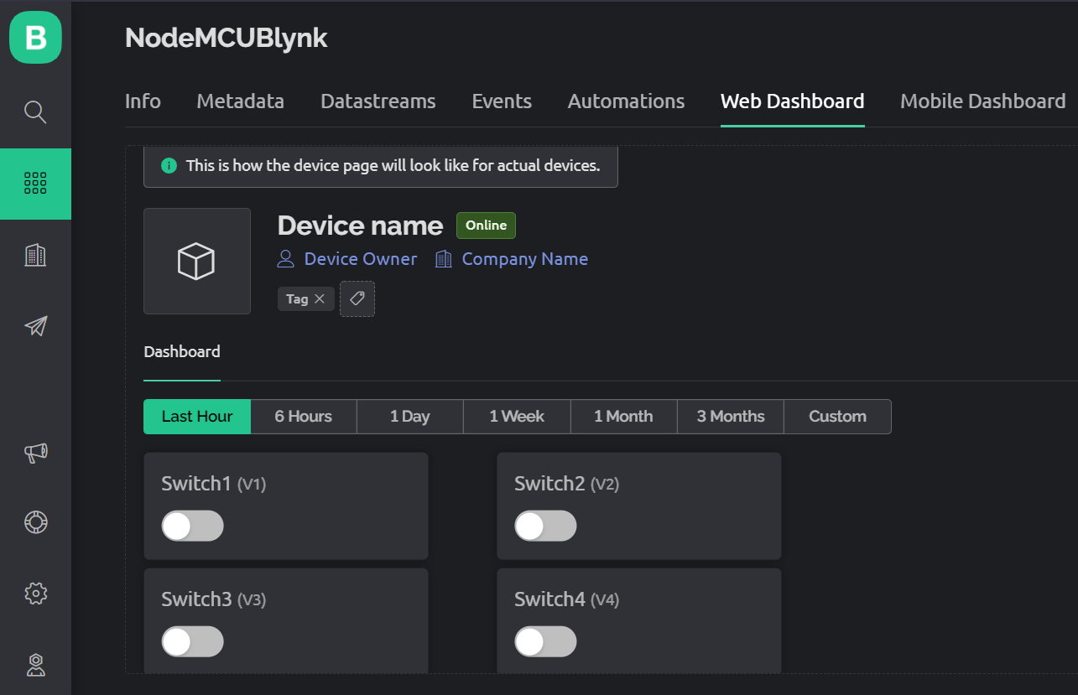
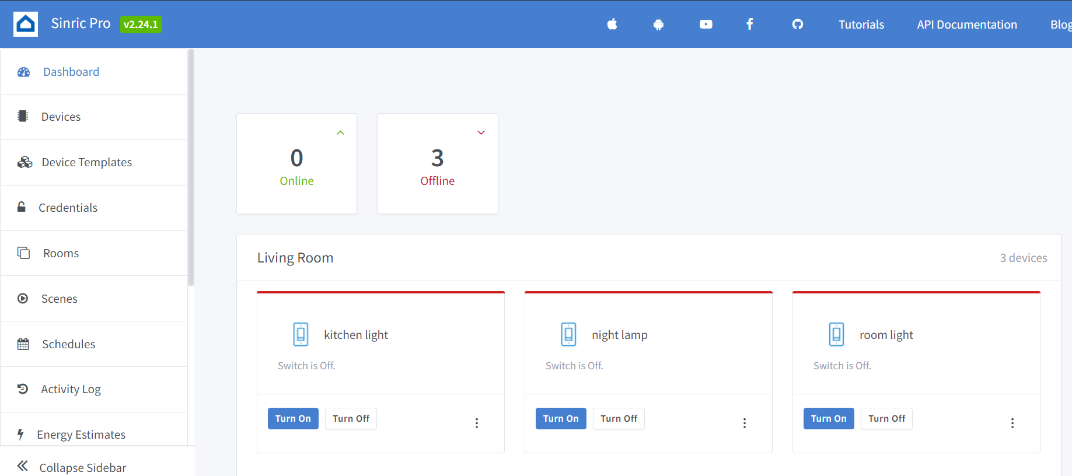
Blynk app and sinric-pro

Slide 13
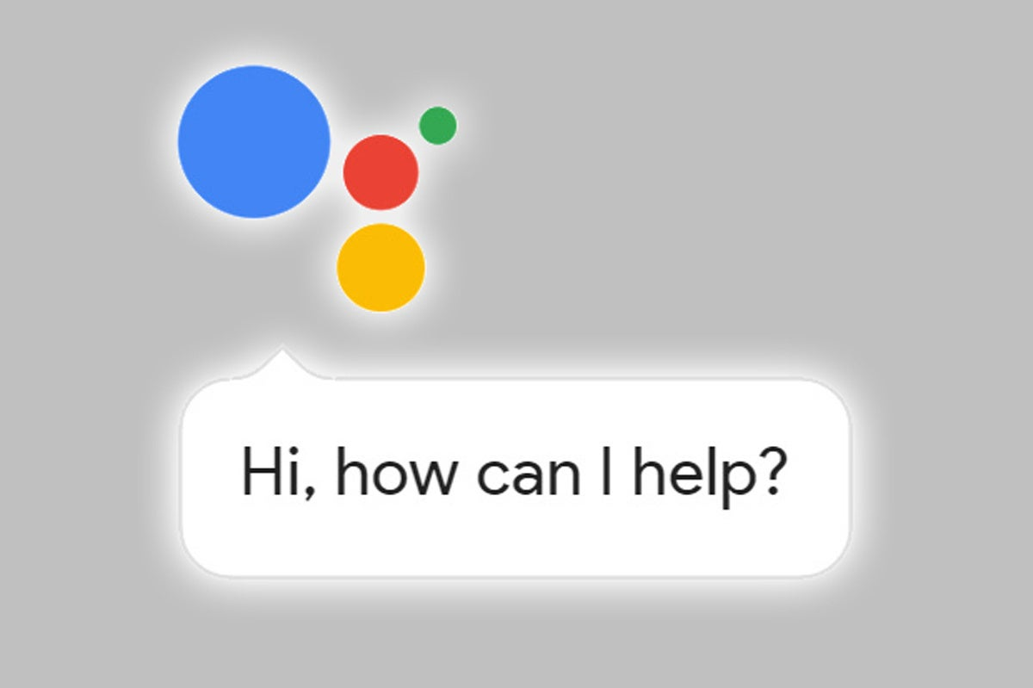
Google commands
Turn on room light
Turn on ALL lights

Slide 14
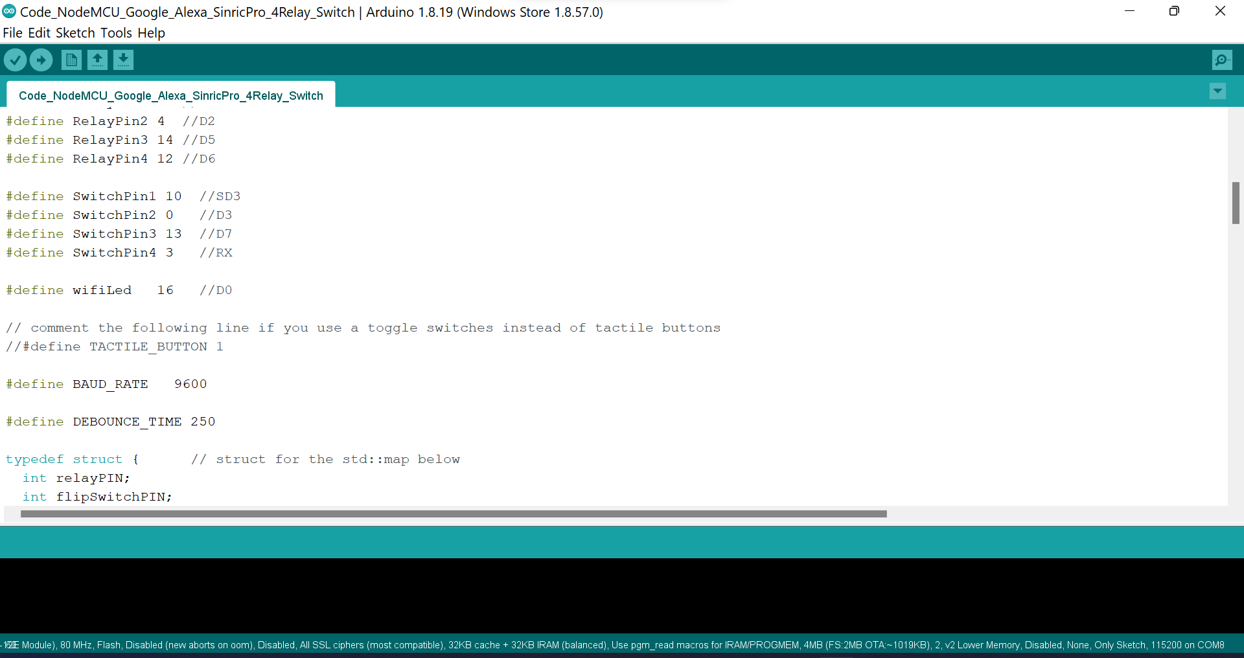
Coding & setup

Slide 15
Simulation

Slide 16
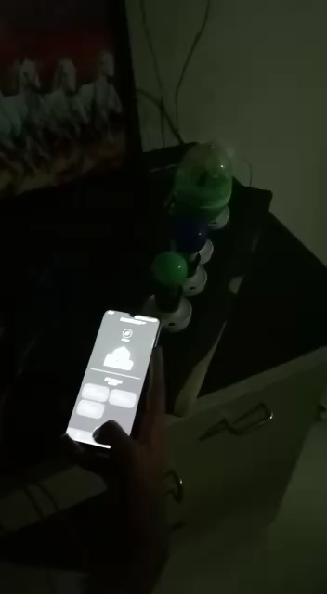

Slide 17
Future scope
As it has WIFI so it can be operated from anywhere in the world where network is available.
It can be deployed in areas where human reach is dangerous or impossible.
Environmental Monitoring
The system can be expanded for energy monitoring, or weather stations.
Secured homes.

Slide 18
References
1. Hayet Lamine and Hafedh Abid, “Remote control of domestic equipment from an Android application based on Raspberry Pi card”, IEEE transaction 15th international conference on Sciences and Techniques of Automatic control computer engineering - STA’2014, Hammamet, Tunisia, December 21-23, 2014.
2. Vaishnavi S. Gunge and Pratibha S. Yalagi, “Smart Home Automation: A Literature Review”, National Seminar on Recent Trends in Data Mining- RTDM 2016.
3. M. B. a. W.Fincher, ”Standards of Human Comfort: Relative and Absolute,” The University of Texas at Austin, Austin, 2009.
4. Archana N. Shewale and Jyoti P. Bari, “Renewable Energy Based Home Automation System Using ZigBee”, IJCTEE Volume 5, Issue 3, June 2015.

Slide 19

Thank you

